Slide 1
Real-Time Person Detection and Face Recognition
KAAN ERDİBİL 1907444
GALİP ŞENOCAK

Slide 2
Objective: Our primary goal is to detect individuals within a video stream. Additionally, we aim to recognize and differentiate faces to determine whether they are known or unknown.
Tools Used: We employ YOLO (You Only Look Once) for efficient object detection. For face encoding and comparison, we utilize the Face Recognition library.

Slide 3
What is Computer Vision? Computer Vision is a field of study dedicated to enabling machines to interpret and understand visual information from the world. It involves the development of algorithms and systems that can process, analyze, and make sense of images and videos, mimicking the human visual system.
YOLO (You Only Look Once): YOLO is a state-of-the-art, real-time object detection system. It uses a single convolutional neural network (CNN) to predict multiple bounding boxes and class probabilities for objects in an image simultaneously. This approach allows YOLO to achieve high speed and accuracy, making it ideal for tasks like person detection in video streams.

Slide 4
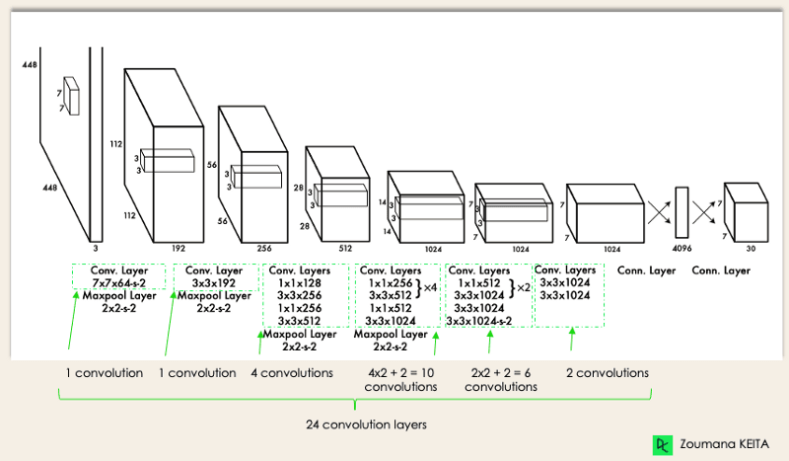
YOLO

Slide 5
Applications of YOLO
Autonomous Driving
Security Surveillance*
Real-Time Tracking

Slide 6
How YOLO Works
Pipeline:
Input Image: YOLO starts by dividing the input image into a grid of smaller cells. Each cell is responsible for detecting objects that fall within its boundaries.
Bounding Boxes and Class Probabilities: For each grid cell, YOLO predicts multiple bounding boxes along with their corresponding confidence scores. It also assigns class probabilities to these boxes, indicating the likelihood of different objects being present in each box.
Non-Maximum Suppression: To refine the results, YOLO applies non-maximum suppression. This technique filters out overlapping boxes, keeping only the ones with the highest confidence scores, thus reducing redundancy and improving detection accuracy.

Slide 7
Advantages:
Fast and Efficient: YOLO's unique architecture allows it to process images in real-time, making it extremely fast and efficient compared to other object detection methods.
High Accuracy in Object Detection: Despite its speed, YOLO maintains high accuracy in detecting and classifying objects, making it a reliable choice for various applications, from autonomous driving to security surveillance.

Slide 8
What is Face Recognition?
Face Recognition Library: This library is utilized for face encoding and comparison. It converts faces into a set of numerical values, or encodings, which can then be compared to determine if they match known faces in a database. This tool is crucial for recognizing and differentiating between known and unknown individuals in the video stream.
Face recognition is the process of identifying or verifying a person from a digital image or video frame. This technology is widely used in various applications, such as security systems, social media, and mobile devices.

Slide 9
STEPS of FR
Face Detection: The first step involves locating faces within an image. This is achieved by scanning the image to identify regions that contain facial features.
Face Encoding: Once a face is detected, it is converted into a numerical vector through face encoding. This vector represents the unique features of the face, such as the distance between the eyes, the shape of the nose, and the structure of the jawline.
Face Matching: The final step involves comparing the encoded face with a database of known faces. The algorithm calculates the similarity between the vectors to determine if there is a match, thereby identifying or verifying the person's identity.

Slide 10
How Face Recognition Works
Load Known Faces: The process begins by loading images of known individuals and creating unique encodings for each face. These encodings serve as reference points for future comparisons.
Detect Faces in Frame: In the current video frame, the system identifies and locates all the faces present. This is the face detection phase where the algorithm scans the frame to pinpoint facial regions.
Compare Faces: The detected faces are then matched against the known face encodings. The system compares the new face encodings with the stored ones to determine if there is a match, effectively recognizing or verifying the individuals.
OpenCV: OpenCV is used for general image processing tasks, such as reading video frames, preprocessing images, and displaying results. It works in conjunction with the face_recognition library to handle the visual data seamlessly.

Slide 11
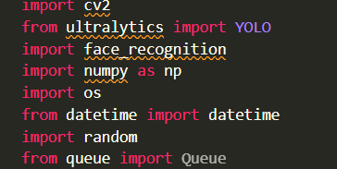
Loading YOLO

Slide 12
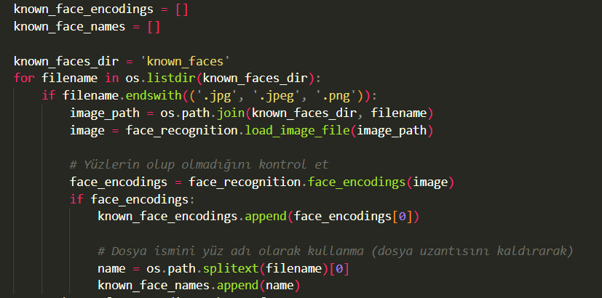
Loading known faces

Slide 13
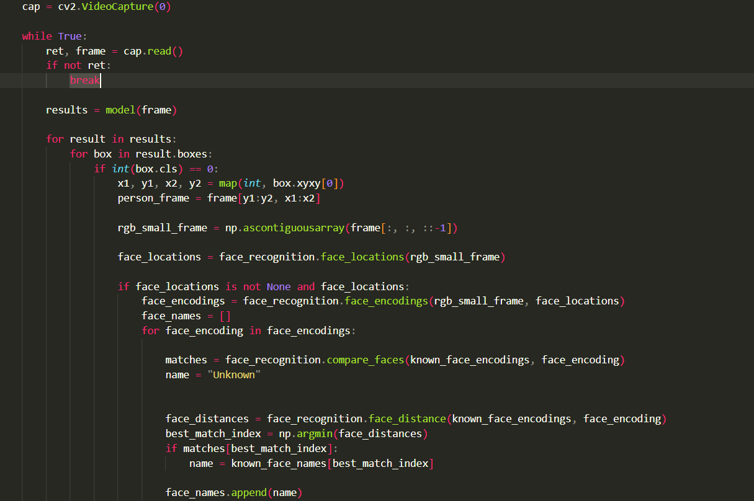
Video Capture and Processing Loop:

Slide 14
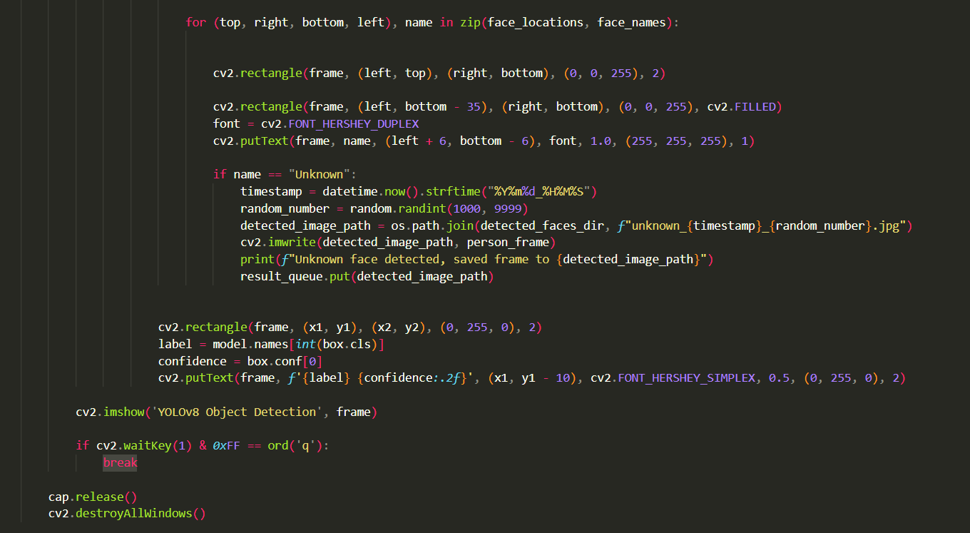
Drawing Bounding Boxes and Labels:

Slide 15
Main Components:
face_detec.py:
Loading Known Faces: Loads and encodes faces from a directory of known faces.
Processing Video Stream: Captures video frames, detects persons using YOLO, and applies face recognition.
main.py:
Server Initialization: Sets up the server and Flask application.
Client Handling: Manages connections and communication with clients.
server:
Server Logic: Handles incoming connections, message processing, and updates.
Flask Routes and Socket.IO: Manages real-time communication between the server and clients.

Slide 16
Summary:
In conclusion, our project successfully integrates YOLO, a state-of-the-art object detection model, with the Face Recognition library to achieve real-time person detection and face recognition. Through a series of steps, we demonstrated how to load known faces, process video streams, and recognize individuals in real-time. The efficiency and accuracy of YOLO in detecting persons, combined with the robust face recognition capabilities, highlight the effectiveness of our approach. The live demo showcased the seamless operation of these technologies, emphasizing their potential applications in various fields such as security surveillance, autonomous driving, and real-time tracking. Our project not only illustrates the power of computer vision but also paves the way for future enhancements and applications.

